Slide 1
Heat Exchange Systems

Slide 2
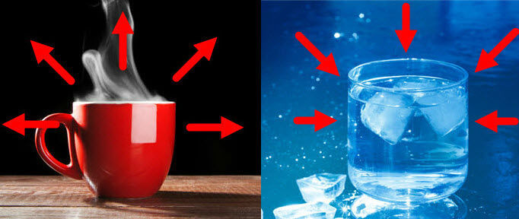
In this Smart Lesson you will learn to:
Explain the process of heat exchange.
Describe how a heat pump works.
Define the coefficient of performance.

Slide 3

Heat pumps use a process called reverse-cycle heating and cooling.
This process allows heat to be taken from a cold place and be transferred to a warmer location.
In winter, heat is extracted from the cold environment and transferred into the warm house. This makes the house warmer.
In summer this process is reversed. Heat is extracted from the cool house and put into the warm environment, making the house colder.

Slide 4
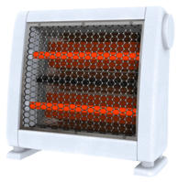
How does this process work?
The Laws of Thermodynamics say that heat can only be passively transferred from hot areas to cold areas!
The trick is that heat pumps use an engine which is used to push heat from cold to hot areas. This means that the laws of thermodynamics still hold up. Phew!

Slide 5
Heat pumps contain an internal coil which is much colder than the external environment.
This means that the environment passively transfers heat to the coil.
This coil contains a refrigerant gas. After this gas has absorbed heat from the environment it is pumped through a compressor. This compressor changes the cool gas into a hot liquid. The temperature and internal energy of the refrigerant increases.
The hot liquid then moves along a copper coil where it radiates heat, causing it to cool down.
After this, it is passed through an expansion valve, which causes the gas to adiabatically expand. The temperature of the refrigerant decreases. It is now a gas again, so the cycle can repeat.

Slide 6
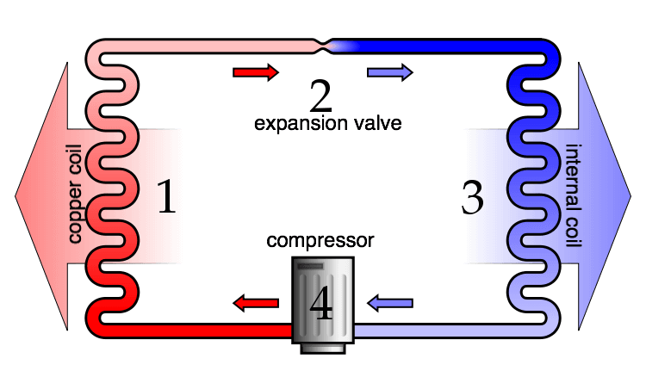

Slide 7
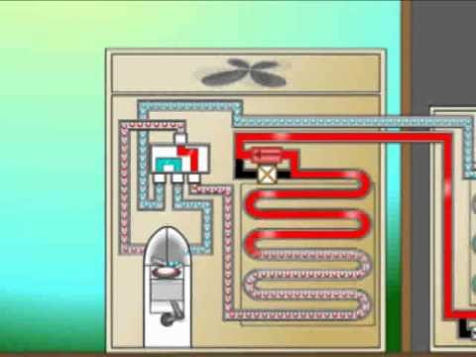

Slide 8

Coefficient of performance.
The effectiveness of a heat pump is called its coefficient of performance, or COP.
Q is the amount of heat removed from the system.
W is the work done on the engine.
Both Q and W are measured in Joules per second(Js⁻¹) or watts(W).
The COP does not have any units.

